Slide 1
Multiple Access Control (MAC) Protocols
Copyright © The McGraw-Hill Companies, Inc. Permission required for reproduction or display.

Slide 2
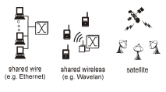
Multiple Access
Broadcast link used in LAN consists of multiple sending and receiving nodes connected to or use a single shared link
Broadcast links Examples

Slide 3

Figure 12.1 Data link layer divided into two functionality-oriented sublayers
Responsible for error and flow control
Link Layer Control (LLC)
Control
MAC
Responsible framing and MAC address and Multiple Access Control

Slide 4
Multiple Access
Problem: When two or more nodes transmit at the same time, their frames will collide and the link bandwidth is wasted during collision
  How to coordinate the access of multiple sending/receiving nodes to the shared link???
Solution: We need a protocol to coordinate the transmission of the active nodes
These protocols are called Medium or Multiple Access Control (MAC) Protocols belong to a sublayer of the data link layer called MAC (Medium Access Control)
What is expected from Multiple Access Protocols:
  Main task is to minimize collisions in order to utilize the bandwidth by:
    Determining when a station can use the link (medium)
    what a station should do when the link is busy
    what the station should do when it is involved in collision

Slide 5
Terms
Throughput: is the amount of data moved successfully from one place to another in a given time period.
propagation delay: is the amount of time it takes for the head of the signal to travel from the sender to the receiver.

Slide 6

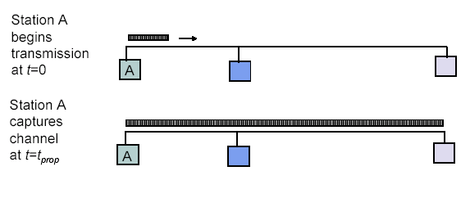
Maximum Propagation Delay
Maximum propagation delay(t_{prop}): time it takes for a bit of a frame to travel between the two most widely separated stations.
The farthest station
Station B receives the first bit of the frame at time t= t_{prop}

Slide 7

For wireless

Slide 8
Random Access
Random Access (or contention) Protocols:
  No station is superior to another station and none is assigned the control over another.
  A station with a frame to be transmitted can use the link directly based on a procedure defined by the protocol to make a decision on whether or not to send.

Slide 9
ALOHA

Slide 10
ALOHA Random Access Scheme
It was developed at the University of Hawaii in the early 1970s to connect computers situated on different Hawaiian islands. The computers of the ALOHA network transmit on the same radio channel whenever they have a packet to transmit.
From time-to-time packet transmission will collide, but these can be treated as transmission errors, and recovery can take place by retransmission. When traffic is very light, the probability of collision is very small, and so retransmissions need to be carried out infrequently.
ALOHA scheme requires stations to use a random retransmission time. (This randomization is intended to spread out the retransmission and reduces the likelihood of additional collisions between stations. )
ALOHA is the father of multiple access protocols.

Slide 11
1 Pure ALOHA
  All frames from any station are of fixed length (L bits)
  Stations transmit at equal transmission time (all stations produce frames with equal frame lengths).
  A station that has data can transmit at any time
  After transmitting a frame, the sender waits for an acknowledgment for an amount of time (time out) equal to the maximum round-trip propagation delay
  Time out= 2* t_{prop}
  If no ACK was received, sender assumes that the frame or ACK has been destroyed and resends that frame after it waits for a random amount of time
  If station fails to receive an ACK after repeated transmissions, it gives up.
  Channel utilization or efficiency or Throughput is the percentage of the transmitted frames that arrive successfully (without collisions)

Slide 12

Pure ALOHA

Slide 13

Critical time for pure ALOHA protocol
T_{fr}= Frame Transmission time
If the frame transmission time is T_{fr}, then the vulnerable time is = 2 T_{fr}.
This means no station should send during the T_{fr} before this station starts transmission and no station should start sending during the T-sec period that the current station is sending.

Slide 14
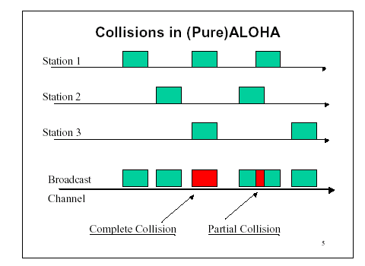
Pure ALOHA
In pure ALOHA, frames are transmitted at completely random times.

Slide 15
2 Slotted ALOHA
Time is divided into slots equal to a frame transmission time (Tfr)
A station can transmit at the beginning of a slot only.
If a station misses the beginning of a slot, it has to wait until the beginning of the next time slot.
A central clock or station informs all stations about the start of a each slot

Slide 16

Slotted ALOHA

Slide 17

In danger time for slotted ALOHA protocol

Slide 18
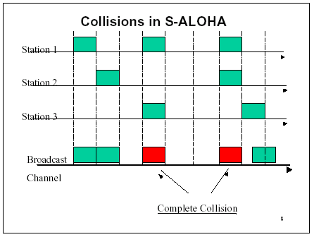
Random Access – Slotted ALOHA

Slide 19
ALOHA
Advantage of ALOHA protocols
  A node that has frames to be transmitted can transmit continuously at the full rate of channel (R bps) if it is the only node with frames
  Simple to be implemented
  No master station is needed to control the medium
Disadvantage
  If (M) nodes want to transmit, many collisions can occur and the rate allocated for each node will not be on average R/M bps
  This causes low channel utilization

Slide 20
BASIS FOR COMPARISON | Pure ALOHA | Slotted ALOHA
Frame Transmission | The user can transmit the data frame whenever the station has the data to be transmitted. | The user has to wait till the next time slot start, to transmit the data frame.
Time | In Pure ALOHA the time is continuous. | In Slotted ALOHA the time is discrete.
Danger Time | = 2 T_{fr} | = T_{fr}

Slide 21
Random Access – Carrier Sense Multiple Access (CSMA)

Slide 22
Random Access – Carrier Sense Multiple Access (CSMA)
A user wishing to transmit, first listens to the medium to see if another transmission is in progress (carrier sense)
Based on the fact that in LAN propagation time is very small
➔ If a frame was sent by a station, All stations knows immediately so they can wait before start sending
  ➔ A station with frames to be sent, should sense the medium for the presence of another transmission (carrier) before it starts its own transmission
This can reduce the possibility of collision but it cannot eliminate it.
  Collision can only happen when more than one station begin transmitting within a short time (the propagation time period)

Slide 23
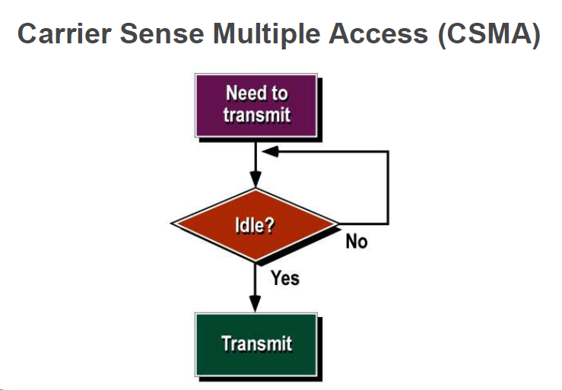

Slide 24

Random Access – Carrier Sense Multiple Access (CSMA)
Vulnerable time for CSMA is the maximum propagation time
The longer the propagation delay, the worse the performance of the protocol because of the above case.

Slide 25
Types of CSMA Protocols
  Different CSMA protocols that determine:
  What a station should do when the medium is idle?
  What a station should do when the medium is busy?
    Non-Persistent CSMA
    1-Persistent CSMA
    p-Persistent CSMA

Slide 26
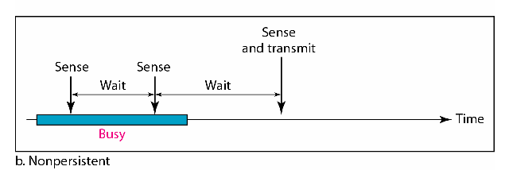
1) Non-persistent CSMA
A station with frames to be sent, should sense the medium:
If medium is idle, transmit; otherwise, go to 2
If medium is busy, (backoff) wait a random amount of time and repeat 1
Performance:
  Random delays reduces probability of collisions because two stations with data to be transmitted will wait for different amount of times.
  Bandwidth is wasted if waiting time (backoff) is large because medium will remain idle following end of transmission even if one or more stations have frames to send
Random Waiting times
Wasted time

Slide 27
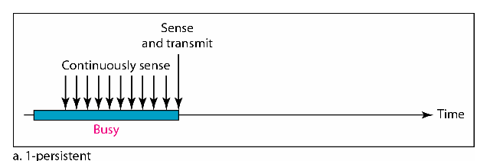
2) 1-persistent CSMA
To avoid idle channel time, 1-persistent protocol used
Station wishing to transmit listens to the medium:
  If medium idle, transmit immediately;
  If medium busy, continuously listen until medium becomes idle; then transmit immediately with probability 1
Performance
  1-persistent stations are selfish
  If two or more stations becomes ready at the same time, collision guaranteed

Slide 28
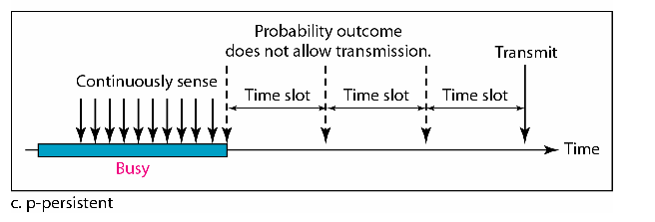
3) P-persistent CSMA
Time is divided to slots where each Time unit (slot) typically equals maximum propagation delay
Station wishing to transmit listens to the medium:
If medium idle,
  transmit with probability (p), OR
  wait one time unit (slot) with probability (1 – p), then repeat 1.
If medium busy, continuously listen until idle and repeat step 1
Performance
  Reduces the possibility of collisions like non-persistent
  Reduces channel idle time like 1-persistent

Slide 29


Slide 30
CSMA/CD (Collision Detection)
CSMA (all previous methods) has an inefficiency:
  If a collision has occurred, the channel is unstable until colliding packets have been fully transmitted
CSMA/CD (Carrier Sense Multiple Access with Collision
Detection) overcomes this as follows:
  While transmitting, the sender is listening to medium for collisions.
  Sender stops transmission if collision has occurred reducing channel wastage .
CSMA/CD is Widely used for bus topology LANs (IEEE 802.3, Ethernet).

Slide 31
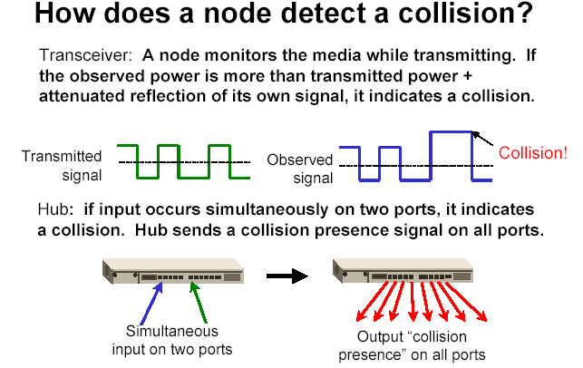
of its own
signal, it means collision occurred

Slide 32
CSMA/CD Protocol
Use one of the CSMA persistence algorithm
(non-persistent, 1-persistent, p-persistent) for transmission
If a collision is detected by a station during its transmission then it should do the following:
  Abort transmission and
  Transmit a jam signal to notify other stations of collision so that they will discard the transmitted frame also to make sure that the collision signal will stay until detected by the furthest station
  After sending the jam signal, backoff (wait) for a random amount of time, then
  Transmit the frame again

Slide 33


Slide 34
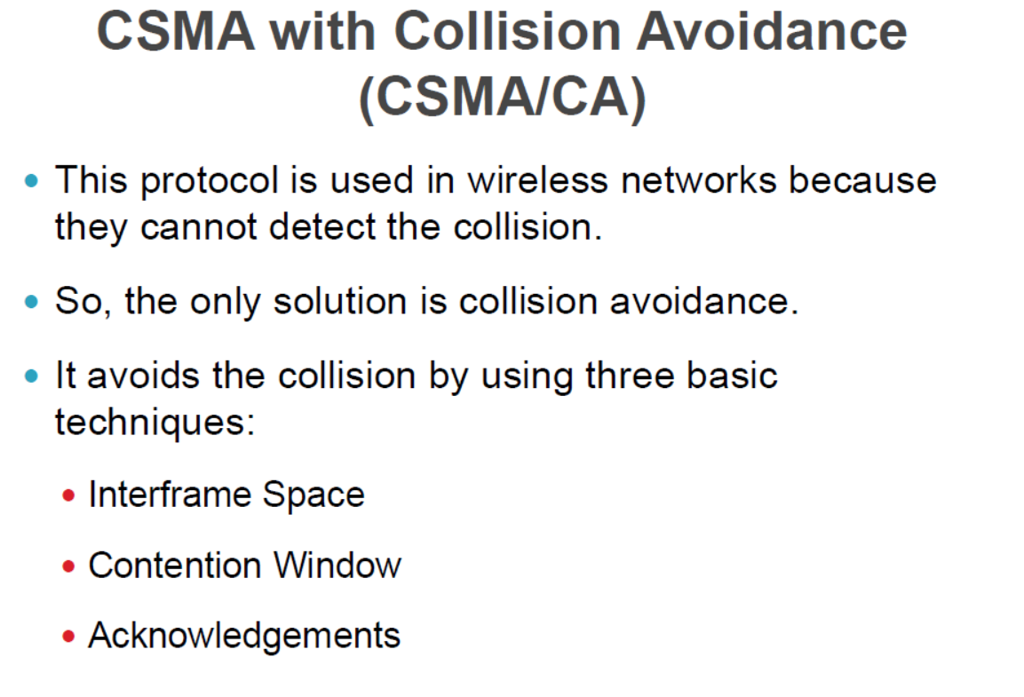

Slide 35


Slide 36
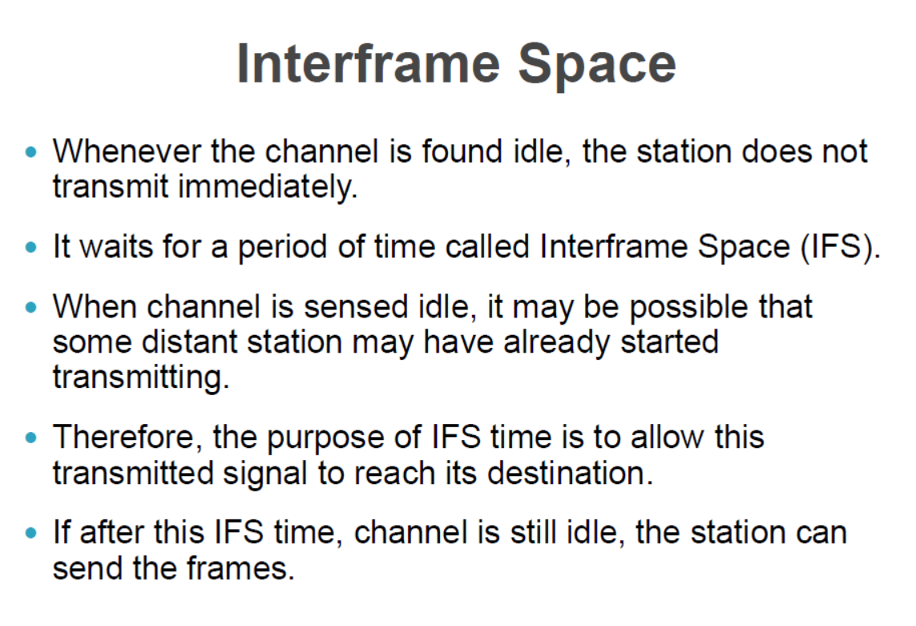

Slide 37
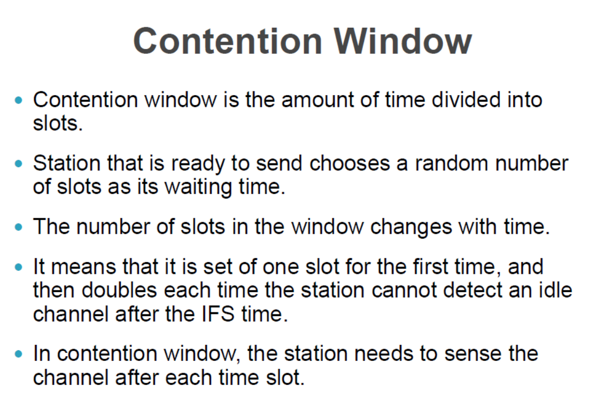

Slide 38
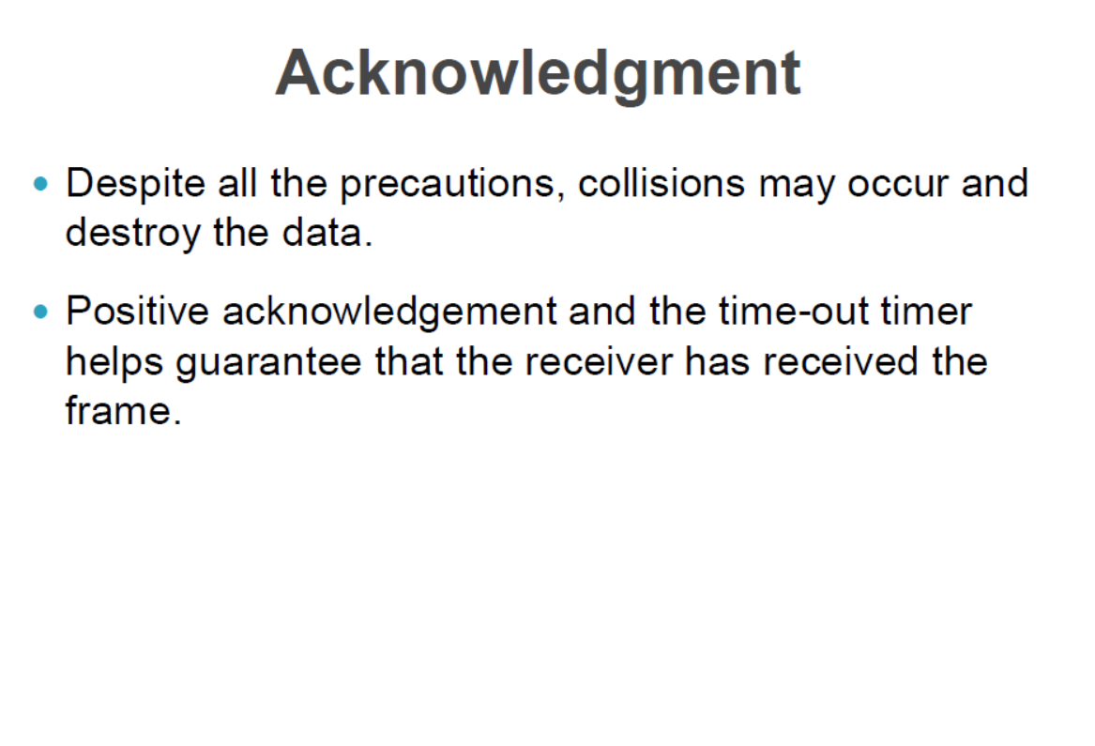

Slide 39
Networking Devices
Network devices or networking hardware are the physical devices that are used for establishing connections and facilating interaction between different devices in a computer network.
Devices such as: hub, switch, bridge, router, gateway, repeaters are commonly used.

Slide 40
Repeaters
A repeater operates at the physical layer. Its job is to regenerate the signal over the same network before the signal becomes too weak or corrupted to extend the length to which the signal can be transmitted over the same network. An important point to be noted about repeaters is that they not only amplify the signal but also regenerate it. When the signal becomes weak, they copy it bit by bit and regenerate it at its star topology connectors connecting following the original strength. It is a 2-port device.

Slide 41
Hub
A hub is a basically multi-port repeater. A hub connects multiple wires coming from different branches, for example, the connector in star topology which connects different stations. Hubs cannot filter data, so data packets are sent to all connected devices. In other words, the collision domain of all hosts connected through Hub remains one. Also, they do not have the intelligence to find out the best path for data packets which leads to inefficiencies and wastage.
Types of Hub:
Active Hub:- These are the hubs that have their power supply and can clean, boost, and relay the signal along with the network. It serves both as a repeater as well as a wiring center. These are used to extend the maximum distance between nodes.
Passive Hub:- These are the hubs that collect wiring from nodes and power supply from the active hub. These hubs relay signals onto the network without cleaning and boosting them and can’t be used to extend the distance between nodes.
Intelligent Hub:- It works like an active hub and includes remote management capabilities. They also provide flexible data rates to network devices. It also enables an administrator to monitor the traffic passing through the hub and to configure each port in the hub.

Slide 42
Bridge
A bridge operates at the data link layer. A bridge is a repeater, with add on the functionality of filtering content by reading the MAC addresses of the source and destination. It is also used for interconnecting two LANs working on the same protocol. It has a single input and single output port, thus making it a 2 port device.
Types of Bridges
Transparent Bridges:- These are the bridge in which the stations are completely unaware of the bridge’s existence i.e. whether or not a bridge is added or deleted from the network, reconfiguration of the stations is unnecessary. These bridges make use of two processes i.e. bridge forwarding and bridge learning.
Source Routing Bridges:- In these bridges, routing operation is performed by the source station and the frame specifies which route to follow. The host can discover the frame by sending a special frame called the discovery frame, which spreads through the entire network using all possible paths to the destination.

Slide 43
Switch
A switch is a multiport bridge with a buffer and a design that can boost its efficiency(a large number of ports imply less traffic) and performance. A switch is a data link layer device. The switch can perform error checking before forwarding data, which makes it very efficient as it does not forward packets that have errors and forward good packets selectively to the correct port only. In other words, the switch divides the collision domain of hosts, but the broadcast domain remains the same.
Types of Switch
Unmanaged switches: These switches have a simple plug-and-play design and do not offer advanced configuration options. They are suitable for small networks or for use as an expansion to a larger network.
Managed switches: These switches offer advanced configuration options such as VLANs, QoS, and link aggregation. They are suitable for larger, more complex networks and allow for centralized management.
Smart switches: These switches have features similar to managed switches but are typically easier to set up and manage. They are suitable for small- to medium-sized networks.
Layer 2 switches: These switches operate at the Data Link layer of the OSI model and are responsible for forwarding data between devices on the same network segment.
Layer 3 switches: These switches operate at the Network layer of the OSI model and can route data between different network segments. They are more advanced than Layer 2 switches and are often used in larger, more complex networks.
PoE switches: These switches have Power over Ethernet capabilities, which allows them to supply power to network devices over the same cable that carries data.
Gigabit switches: These switches support Gigabit Ethernet speeds, which are faster than traditional Ethernet speeds.

Slide 44
Router
Routers are small physical devices that operate at the network layer to join multiple networks together.
A router is a device that routes data packets based on their IP addresses.
Routers normally connect LANs and WANs and have a dynamically updating routing table based on which they make decisions on routing the data packets.
A Router divides the broadcast domains of hosts connected through it.
Routers perform the traffic directing functions on the Internet. A data packet is typically forwarded from one router to another through the networks that constitute the internetwork until it reaches its destination code.
Routers may also be used to connect two or more logical groups of computer devices known as subnets, each with a different subnetwork address. The subnet addresses recorded in a router do not necessarily map directly to the physical interface connections.
Two types of routers −
Static routers – Static routers are configured manually and route data packets based on the information in a router table.
Dynamic routers – Dynamic routers use adaptive routing which is a process where a router can forward data by a different route.

Slide 45
Gateway
A gateway is an internetworking capable of joining together two networks that use different base protocols.
A network gateway can be implemented completely in software, hardware, or a combination of both, depending on the types of protocols they support.
A network gateway can operate at any level of the OSI model. A broadband router typically serves as the network gateway, although ordinary computers can also be configured to perform equivalent functions.
  A gateway is a router or proxy server that routes between networks.
  A gateway belongs to the same subnet to which the PC belongs.

